Slide 1
Augmented Reality :Smart Education
Satya Venkata Ranga Janaki Sriram Mentey
Rajiv Varma Chithari Amaravathi
Sandeep NLNS
Sireesha Pandala

Slide 2
Increment 2 tasks executed .
Recognizing the simple mathematical Expressions.
Evaluating those expressions and Displaying the result.

Slide 3
API USED
Optical Character Recognition :
It's a type of software (program) that can automatically analyze printed text and turn it into a form that a computer can process more easily. OCR is at the heart of everything from handwriting analysis programs on mobile phones to the gigantic mail-sorting machines that ensure all those millions of letters reach their destinations.
OCR is the process of turning a picture of text into text itself—in other words, producing something like a TXT or DOC file from a scanned JPG of a printed or handwritten page.

Slide 4
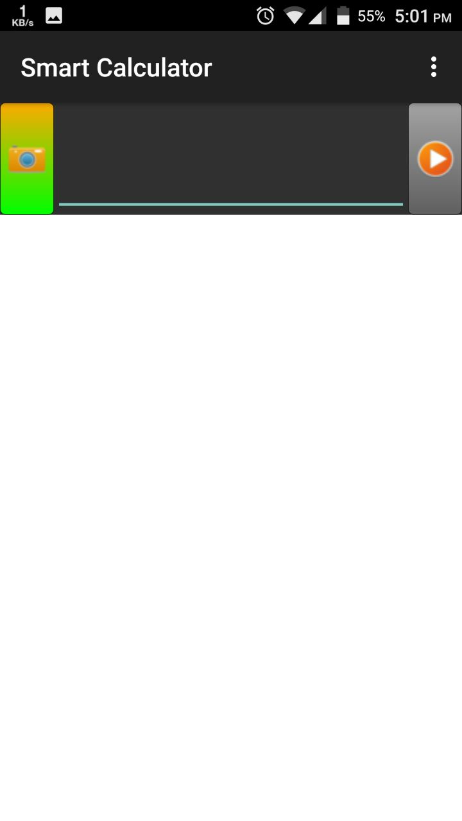
Output of Increment 2

Slide 5
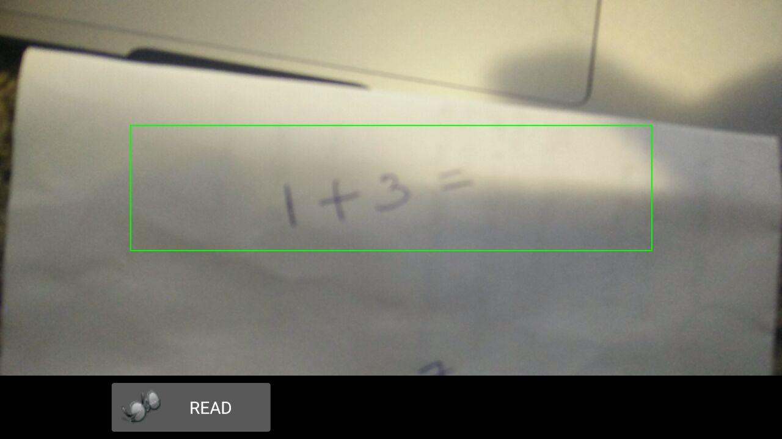
Scanning the simple expression :

Slide 6
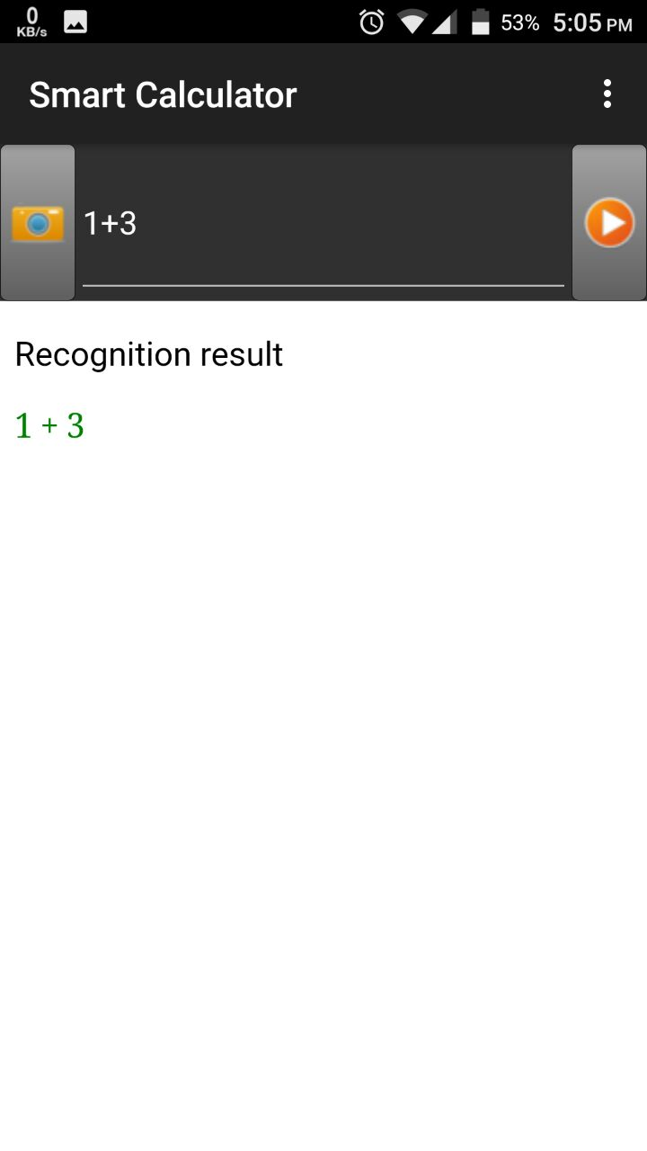
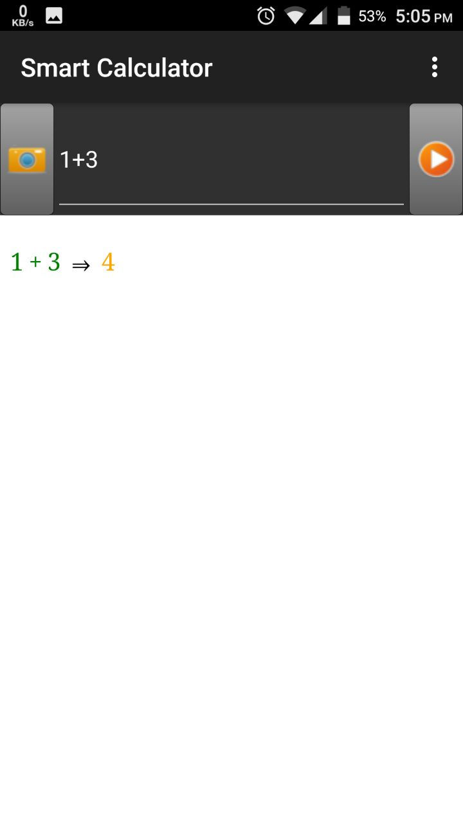
Recognition Result :

Slide 7
Tasks to be completed by Increment 3 :
Work on Expressions like 2x +3 = 10 and display the value of x
Work on Geometric Figures to display possible result .
Develop tic tac toe game.

Slide 8
THANK YOU

